Slide 1
MONASH INFORMATION
TECHNOLOGY
Parallel Classification
How to parallelize the training process of ML models?
Prajwol Sangat
Update by CM Ting (15 April 2022)

Slide 2
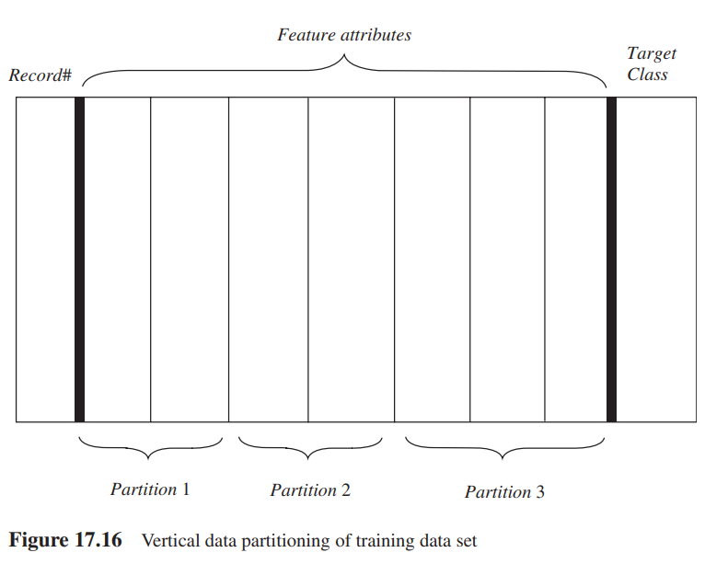
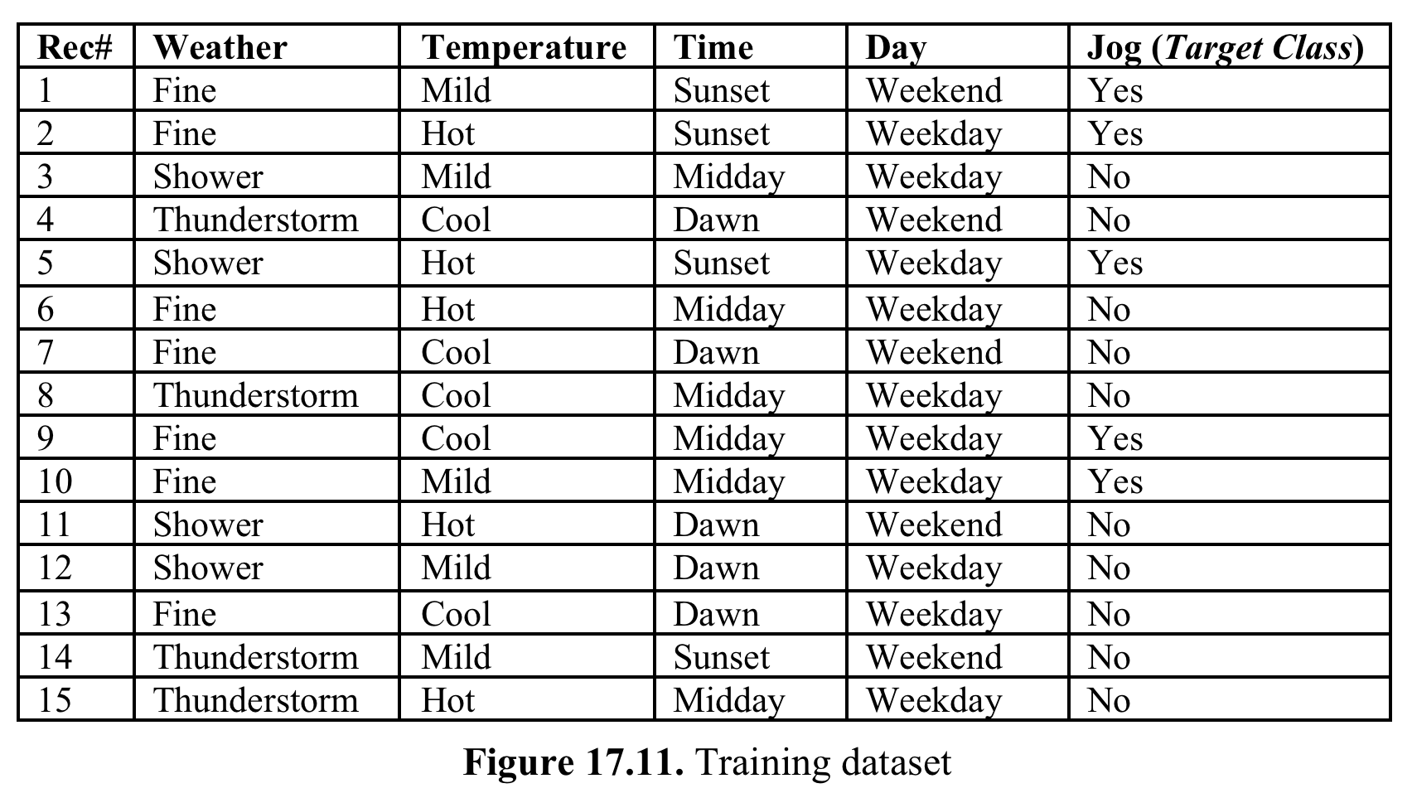
Parallel Classification: Decision Tree
Data parallelism

Slide 3
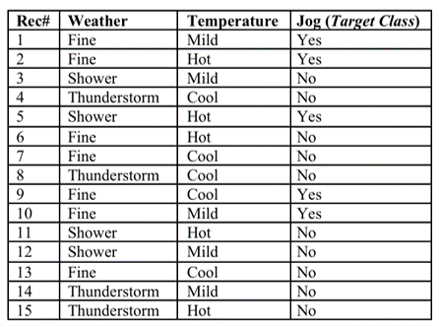
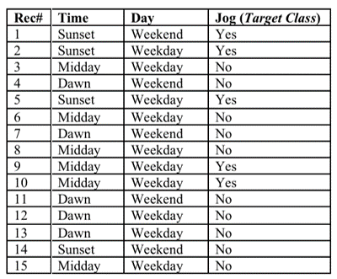
Parallel Classification: Decision Tree
Data parallelism: Vertical Partitioning of Training dataset
Feature attributes are partitioned
Record# & Target are replicated in each partition
Partition 1
Partition 2

Slide 4
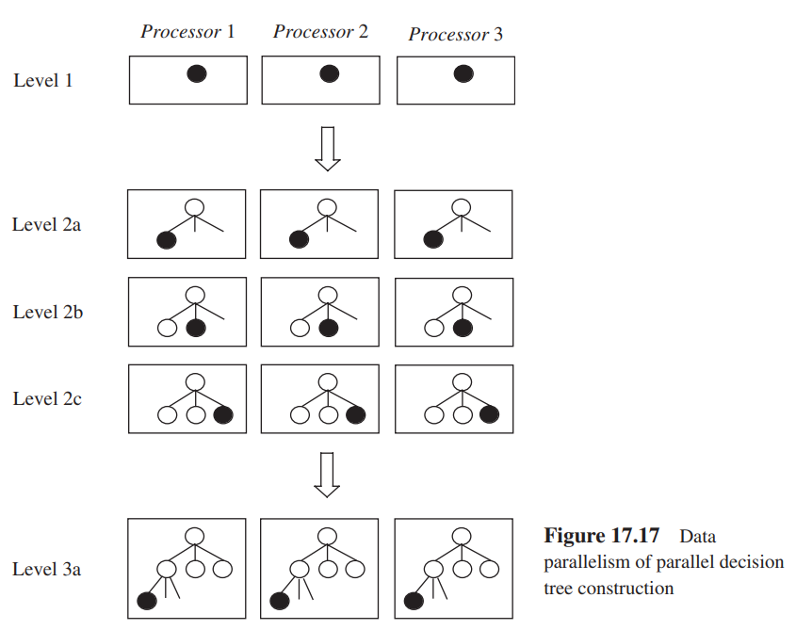
Parallel Classification: Decision Tree
Data parallelism – Horizontal Partitioning of dataset
All processors will process one particular node at each level or sub-level at a time
Parallelism: Each processor will compute IGs for certain attributes (in parallel), which are then shared to determine splitting
‘Intra tree node parallelism’

Slide 5
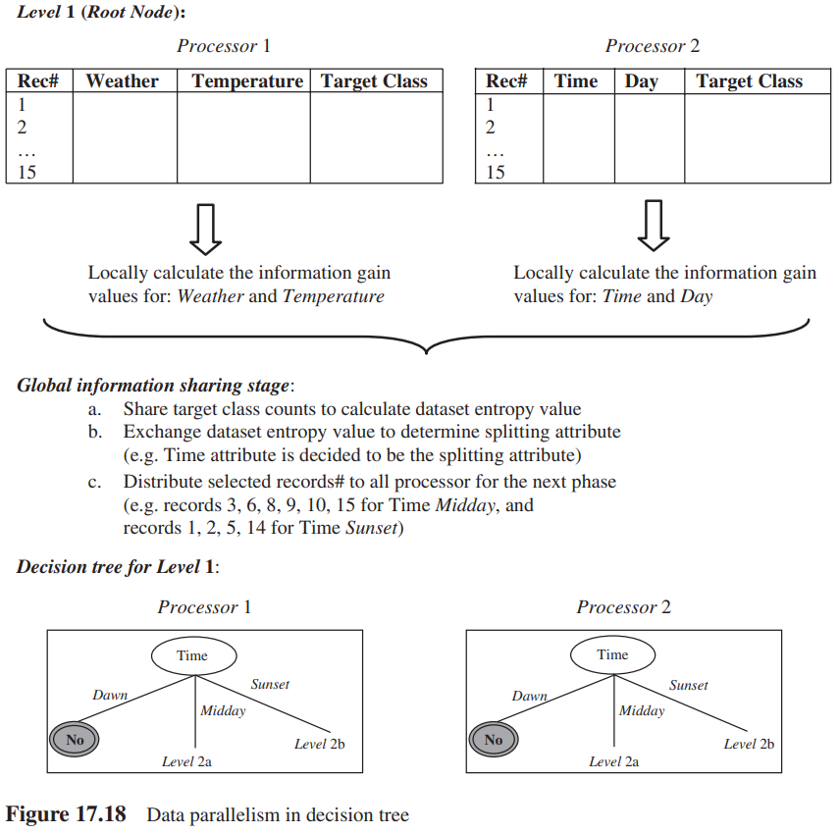
Parallel Classification: Decision Tree
Data parallelism

Slide 6
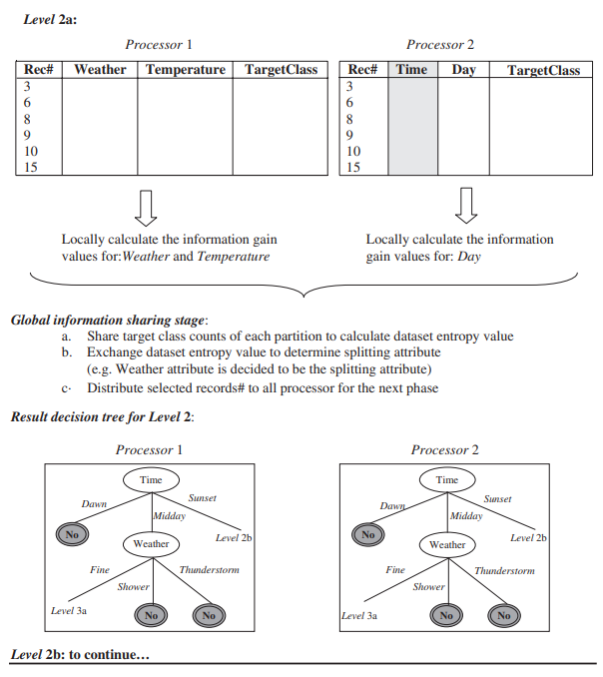
Parallel Classification: Decision Tree
Data parallelism

Slide 7
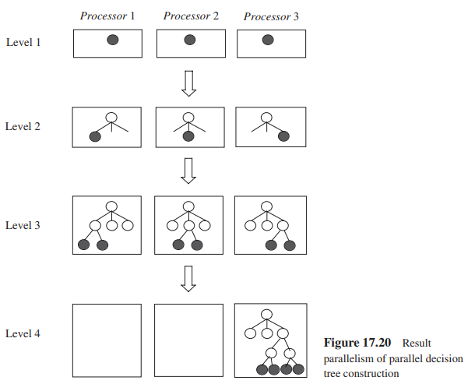
Parallel Classification: Decision Tree
Result parallelism
Level 1: Root node processed by all P’s
Level 2: Each node processed independently
Level 3: After splitting, each P will process the associated child nodes
Multiple nodes are processed concurrently using several processors at each level
Main rule: A processor that processes a child node will also its parent nodes
‘Inter tree node parallelism’

Slide 8
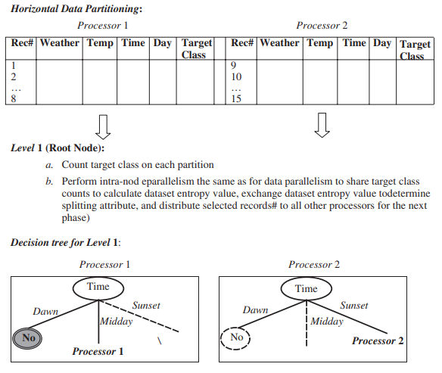
Parallel Classification: Decision Tree
Result parallelism
Recall: To compute entropy & IG, count information from the entire dataset is needed
Sharing of count information between P’s

Slide 9
Parallel Classification: Decision Tree
 |  | Jog
 |  | Yes | No
Time | Dawn | 0 | 5 | 5
 | Midday | 2 | 4 | 6
 | Sunset | 3 | 1 | 4
 |  |  |  | 15
 |  | Jog
 |  | Yes | No
Day | Weekend | 4 | 6 | 10
 | Weekday | 1 | 4 | 5
 |  |  |  | 15
Result parallelism
Jog
Yes | No
5 | 10
 |  | Jog
 |  | Yes | No
Weather | Fine | 4 | 3 | 7
 | Shower | 1 | 3 | 4
 | Thunderstorm | 0 | 4 | 4
 |  |  |  | 15
 |  | Jog
 |  | Yes | No
Temperature | Hot | 2 | 3 | 5
 | Mild | 3 | 2 | 5
 | Cool | 1 | 4 | 5
 |  |  |  | 15
Notes:
Remember these table.
I showed this earlier that had the count for each attribute.
You can think of these shared between both processors to find the root node for splitting.

Slide 10
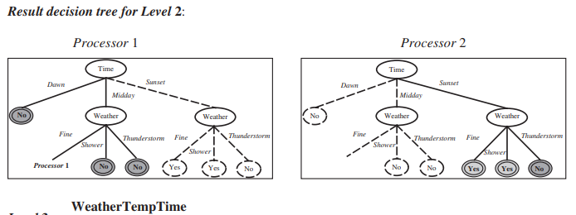
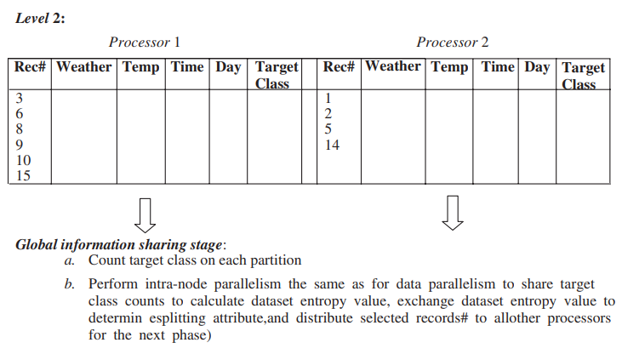
Parallel Classification: Decision Tree
Result parallelism
All the necessary information/counts are available in each partition to compute IG to determine splitting

Slide 11
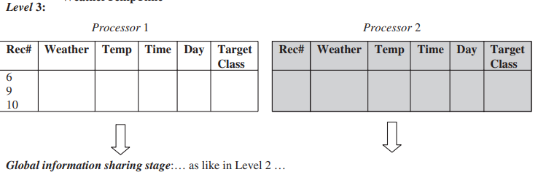
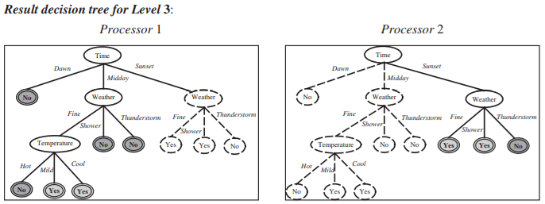
Parallel Classification: Decision Tree

